Slide 1


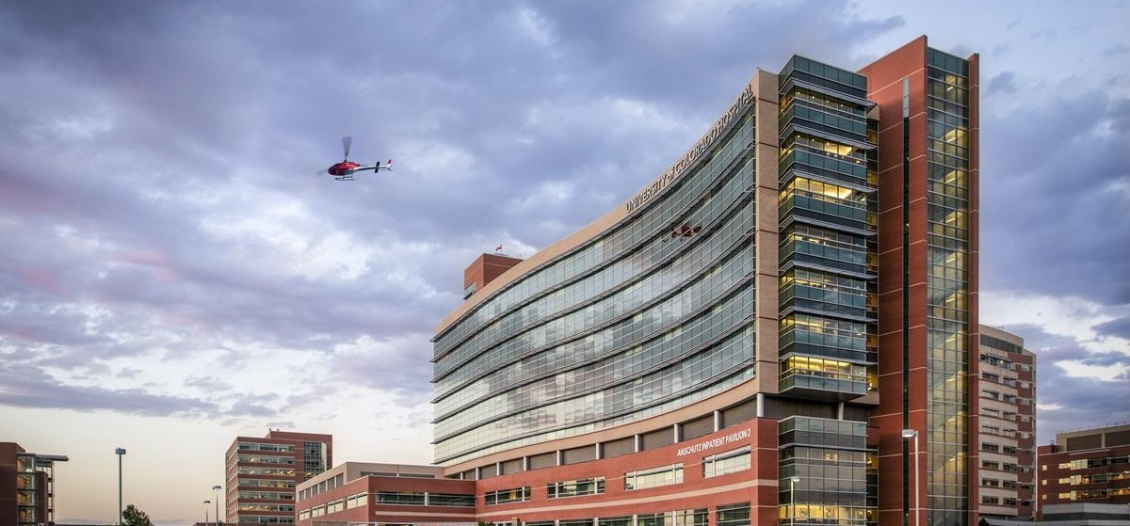
UCHEALTH DIRECT-TO-EMPLOYER PLAN
November 05, 2024

Slide 2



Founded in 1979 and headquartered in Indianapolis, IN​
Full-service TPA specializing in the administration of self-funded health plans and population health management​
One of the country’s largest independently-owned TPAs
The Key Family is a commonly-held group of benefits related organizations with:​
3,000+ corporate clients​
3.0 million members under management​
700 Employees
Exclusive Relationships
We know The Market – Agents, Networks, and MGAs

Slide 3


Market Leader in Private Labeled DTE Plans
Louisville, KY
OneHealth Plan
Cincinnati, OH
TCH Optimal
Bentonville, AR
Northwest Health Plan
Knoxville, TN
East Tennessee Health Plan
Meridian, MS
Affinity Health Plan
Fort Myers, FL
Lee Health Care Partners

Slide 4
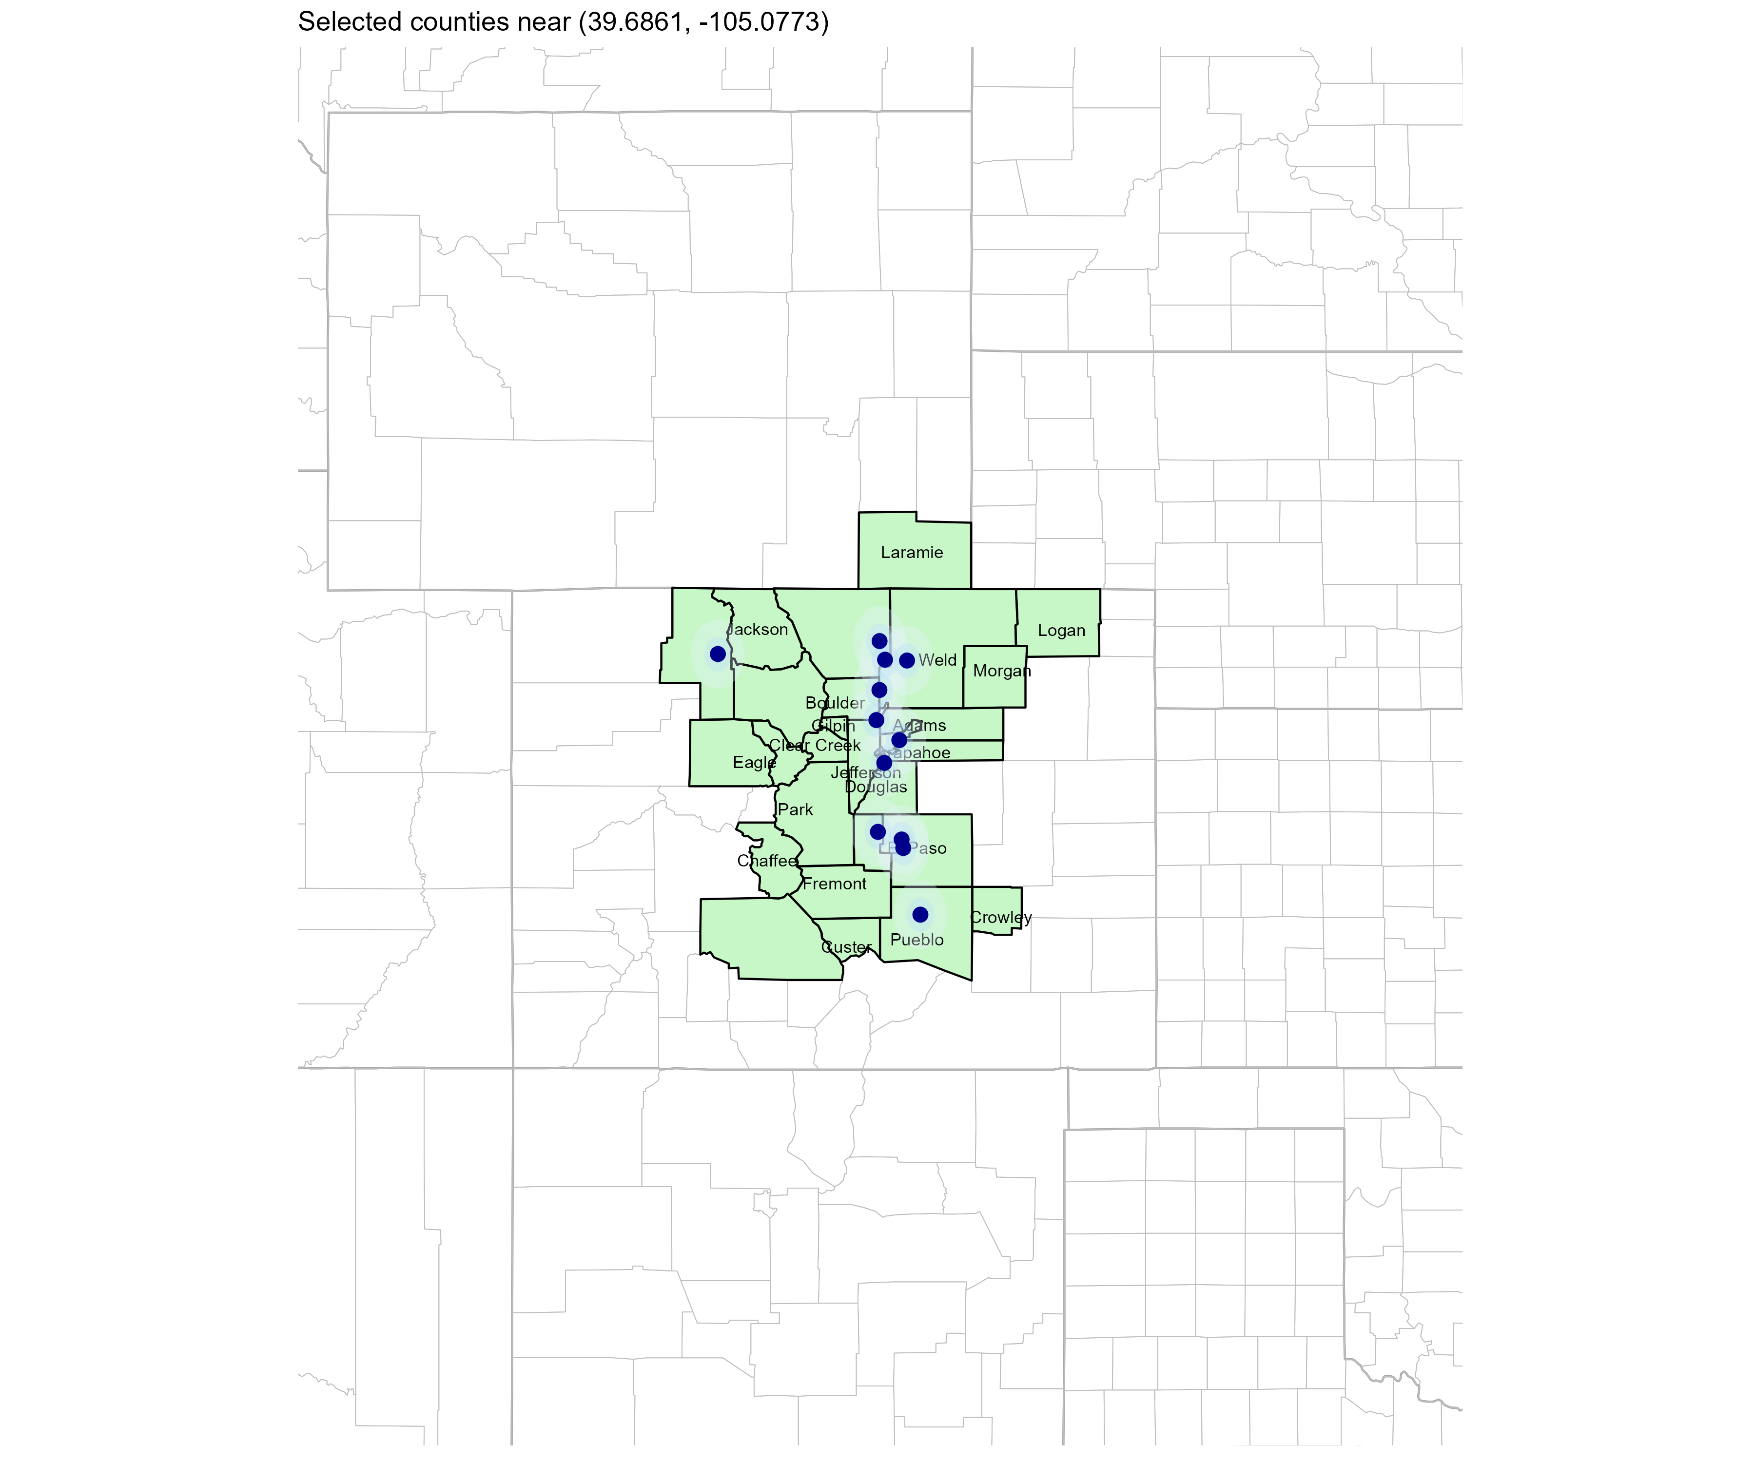
Significant Opportunity for Plan Growth Researched for Central Colorado
Target Market 8,000+ Employers 1,500,000+ Employees 2,400,000+ Members
 | Employer Size Group (# of Employees)
Commercial Employers With Headquarters | 50-100 | 101-200 | 201-400 | 401-1,000 | 1,001-3,000 | 3,000+
In Catchment Area | 911 | 352 | 192 | 141 | 56 | 29
Total Employees at Employers | 50-100 | 101-200 | 201-400 | 401-1,000 | 1,001-3,000 | 3,000+
Headquartered in Catchment Area | 349,200 | 293,400 | 352,800 | 455,700 | 424,000 | 786,000
Total Members with Employers | 50-100 | 101-200 | 201-400 | 401-1,000 | 1,001-3,000 | 3,000+
Headquartered in Catchment Area | 628,600 | 528,100 | 635,000 | 820,300 | 763,200 | 1,414,800
Estimates include Adams, Alamosa, Arapahoe, Archuleta, Baca, Bent, Boulder, Chaffee, Cheyenne, Clear Creek, Crowley, Custer, Denver, Douglas, Eagle, El Paso, Fremont, Garfield, Gilpin, Grand, Huerfano, Jackson, Jefferson, Kiowa, Larimer, Las Animas, Logan, Moffat, Morgan, Otero, Park, Phillips, Prowers, Pueblo, Rio Grande, Routt, Saguache, Sedgwick, Summit, Teller, Weld, Yuma, Box Butte, Scotts Bluff, Colfax, Albany, Carbon, Goshen, Laramie, and Platte Counties

Slide 5
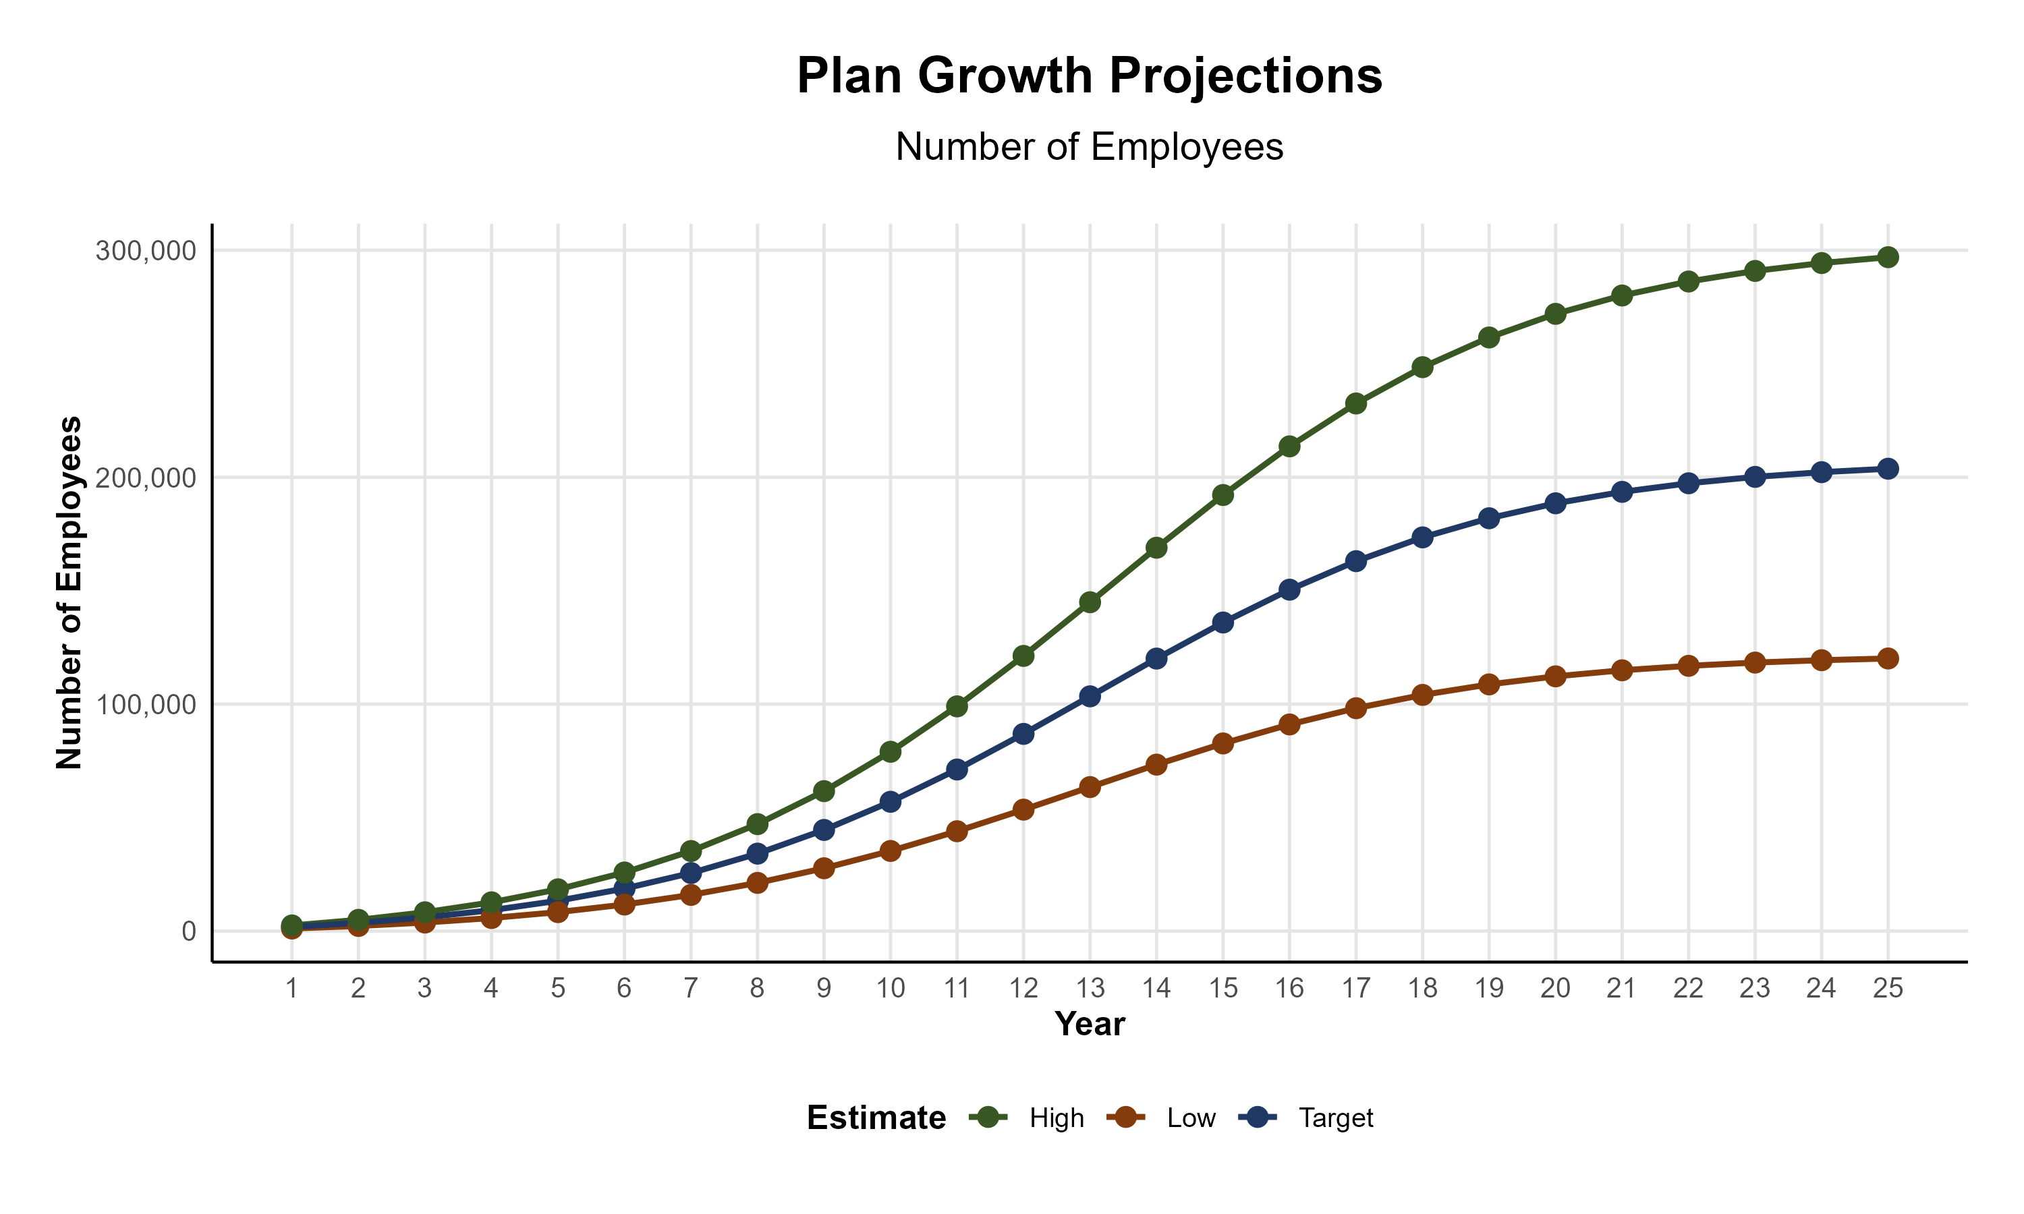
Plan Potential Growth Paths
Self Funded
1,351K
PLAN GROWTH POTENTIAL
2,395K
Insured
Working Age
3,364K
Population
5,506K
Estimates include Adams, Alamosa, Arapahoe, Archuleta, Baca, Bent, Boulder, Chaffee, Cheyenne, Clear Creek, Crowley, Custer, Denver, Douglas, Eagle, El Paso, Fremont, Garfield, Gilpin, Grand, Huerfano, Jackson, Jefferson, Kiowa, Larimer, Las Animas, Logan, Moffat, Morgan, Otero, Park, Phillips, Prowers, Pueblo, Rio Grande, Routt, Saguache, Sedgwick, Summit, Teller, Weld, Yuma, Box Butte, Scotts Bluff, Colfax, Albany, Carbon, Goshen, Laramie, and Platte Counties

Slide 6

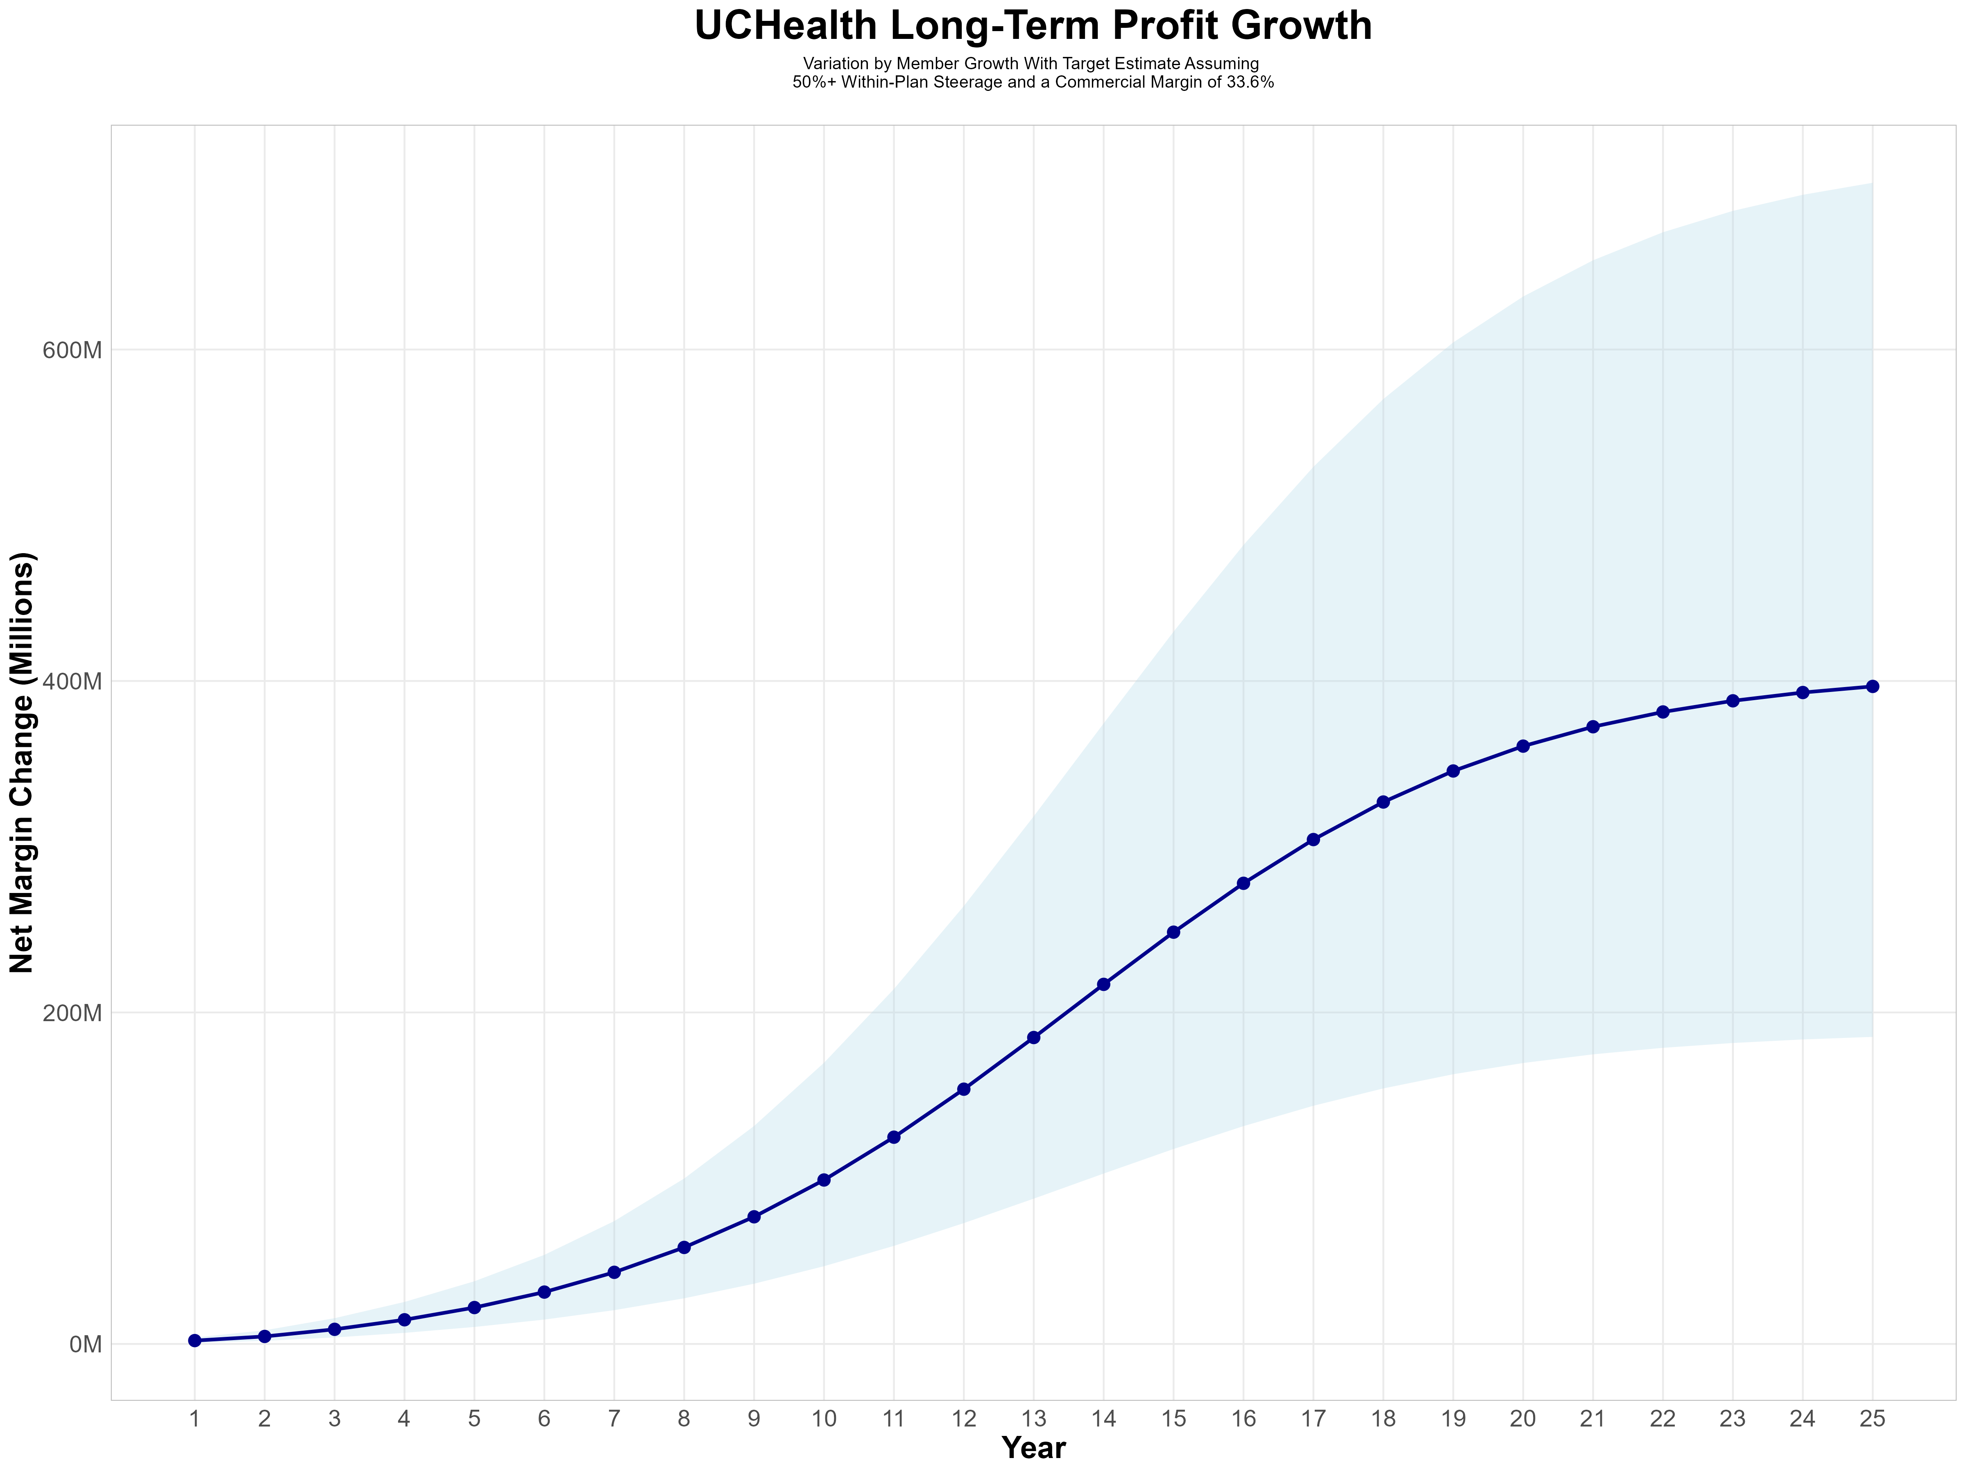
Growing Powerful, Lasting Profitability
Early Stage
Gaining Name Recognition, Early Growth
New Revenue:
New Profit:
$68.28M
$23.08M
Growth Stage
Strong Reputation, Strong Growth
New Revenue:
New Profit:
$507.93M
$172.79M
Mature Stage
High Profitability, Market Saturation
New Revenue:
New Profit:
$1068.13M
$363.25M

Slide 7
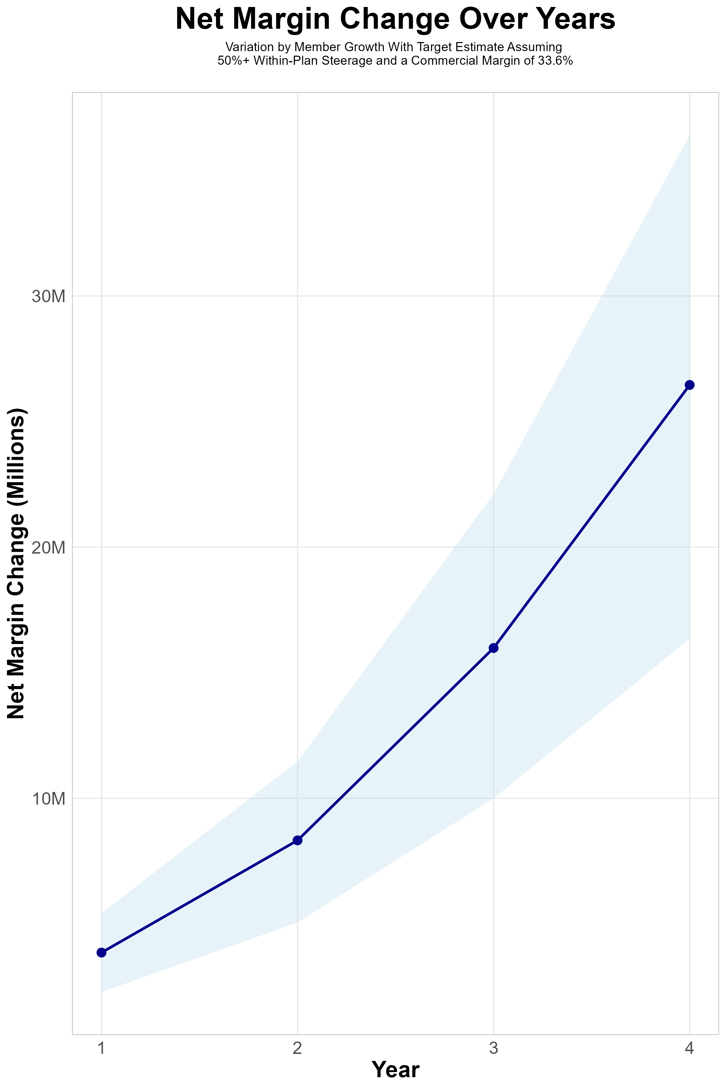
FOUR-YEAR PROJECTIONS
Target Member Growth | Target Member Growth | Target Member Growth | Target Member Growth | Target Member Growth
Metric | Year 1 | Year 2 | Year 3 | Year 4
Number of Members | 3,200 | 6,500 | 10,800 | 16,600
Incremental Margin | 4,152.1K | 8,430.2K | 16,035.8K | 26,439.1K
Network Access Fee | 38.4K | 78.0K | 129.6K | 199.2K
Implementation Fee (One-Time) | -150.0K | 0.0K | 0.0K | 0.0K
Sales and Marketing Costs | -180.0K | -180.0K | -180.0K | -180.0K
Net Margin Change | 3,860.5K | 8,328.2K | 15,985.4K | 26,458.3K
High Member Growth | High Member Growth | High Member Growth | High Member Growth | High Member Growth
Metric | Year 1 | Year 2 | Year 3 | Year 4
Number of Members | 4,400 | 8,900 | 14,900 | 22,800
Incremental Margin | 5,709.2K | 11,542.9K | 22,123.5K | 36,314.0K
Network Access Fee | 52.8K | 106.8K | 178.8K | 273.6K
Implementation Fee (One-Time) | -150.0K | 0.0K | 0.0K | 0.0K
Sales and Marketing Costs | -180.0K | -180.0K | -180.0K | -180.0K
Net Margin Change | 5,432.0K | 11,469.7K | 22,122.3K | 36,407.6K
Low Member Growth | Low Member Growth | Low Member Growth | Low Member Growth | Low Member Growth
Metric | Year 1 | Year 2 | Year 3 | Year 4
Number of Members | 2,000 | 4,000 | 6,800 | 10,300
Incremental Margin | 2,595.1K | 5,187.8K | 10,096.6K | 16,405.0K
Network Access Fee | 24.0K | 48.0K | 81.6K | 123.6K
Implementation Fee (One-Time) | -150.0K | 0.0K | 0.0K | 0.0K
Sales and Marketing Costs | -180.0K | -180.0K | -180.0K | -180.0K
Net Margin Change | 2,289.1K | 5,055.8K | 9,998.2K | 16,348.6K

Slide 8
Direct-to-Employer Strategy: Only Available to Premier Health Systems
STRONG Brand Quality
EXTENSIVE Patient Access
AFFORDABLE Value Pricing
EXCELLENT Care Quality

Slide 9
UCHealth is Patient Recommended
Health System | HCAHPS Recommendation Percentile | CMS Stars Percentile | Mortality Percentile | Readmission Percentile | KBA Brand Quality Score
Boulder Community Health | 84 | 61 | 69 | 70 | 74
Intermountain Health | 76 | 89 | 57 | 82 | 70
AdventHealth | 71 | 93 | 61 | 74 | 69
UCHealth | 70 | 87 | 68 | 84 | 68
CommonSpirit Health | 61 | 89 | 67 | 78 | 66
Other Independent Hospitals | 61 | 100 | 67 | 68 | 65
Banner Health | 51 | 78 | 60 | 73 | 63
HCA Healthcare | 46 | 82 | 76 | 68 | 60
Denver Health | 37 | 31 | 57 | 64 | 58
Cheyenne Regional Health System | 37 | 87 | 66 | 83 | 57
Regional West Health Services | 1 | 10 | 48 | 56 | 45
Based on quality measures and HCAHPS feedback, KBA estimates that in addition to strong market access, UC Health is a quality brand leader.

Slide 10
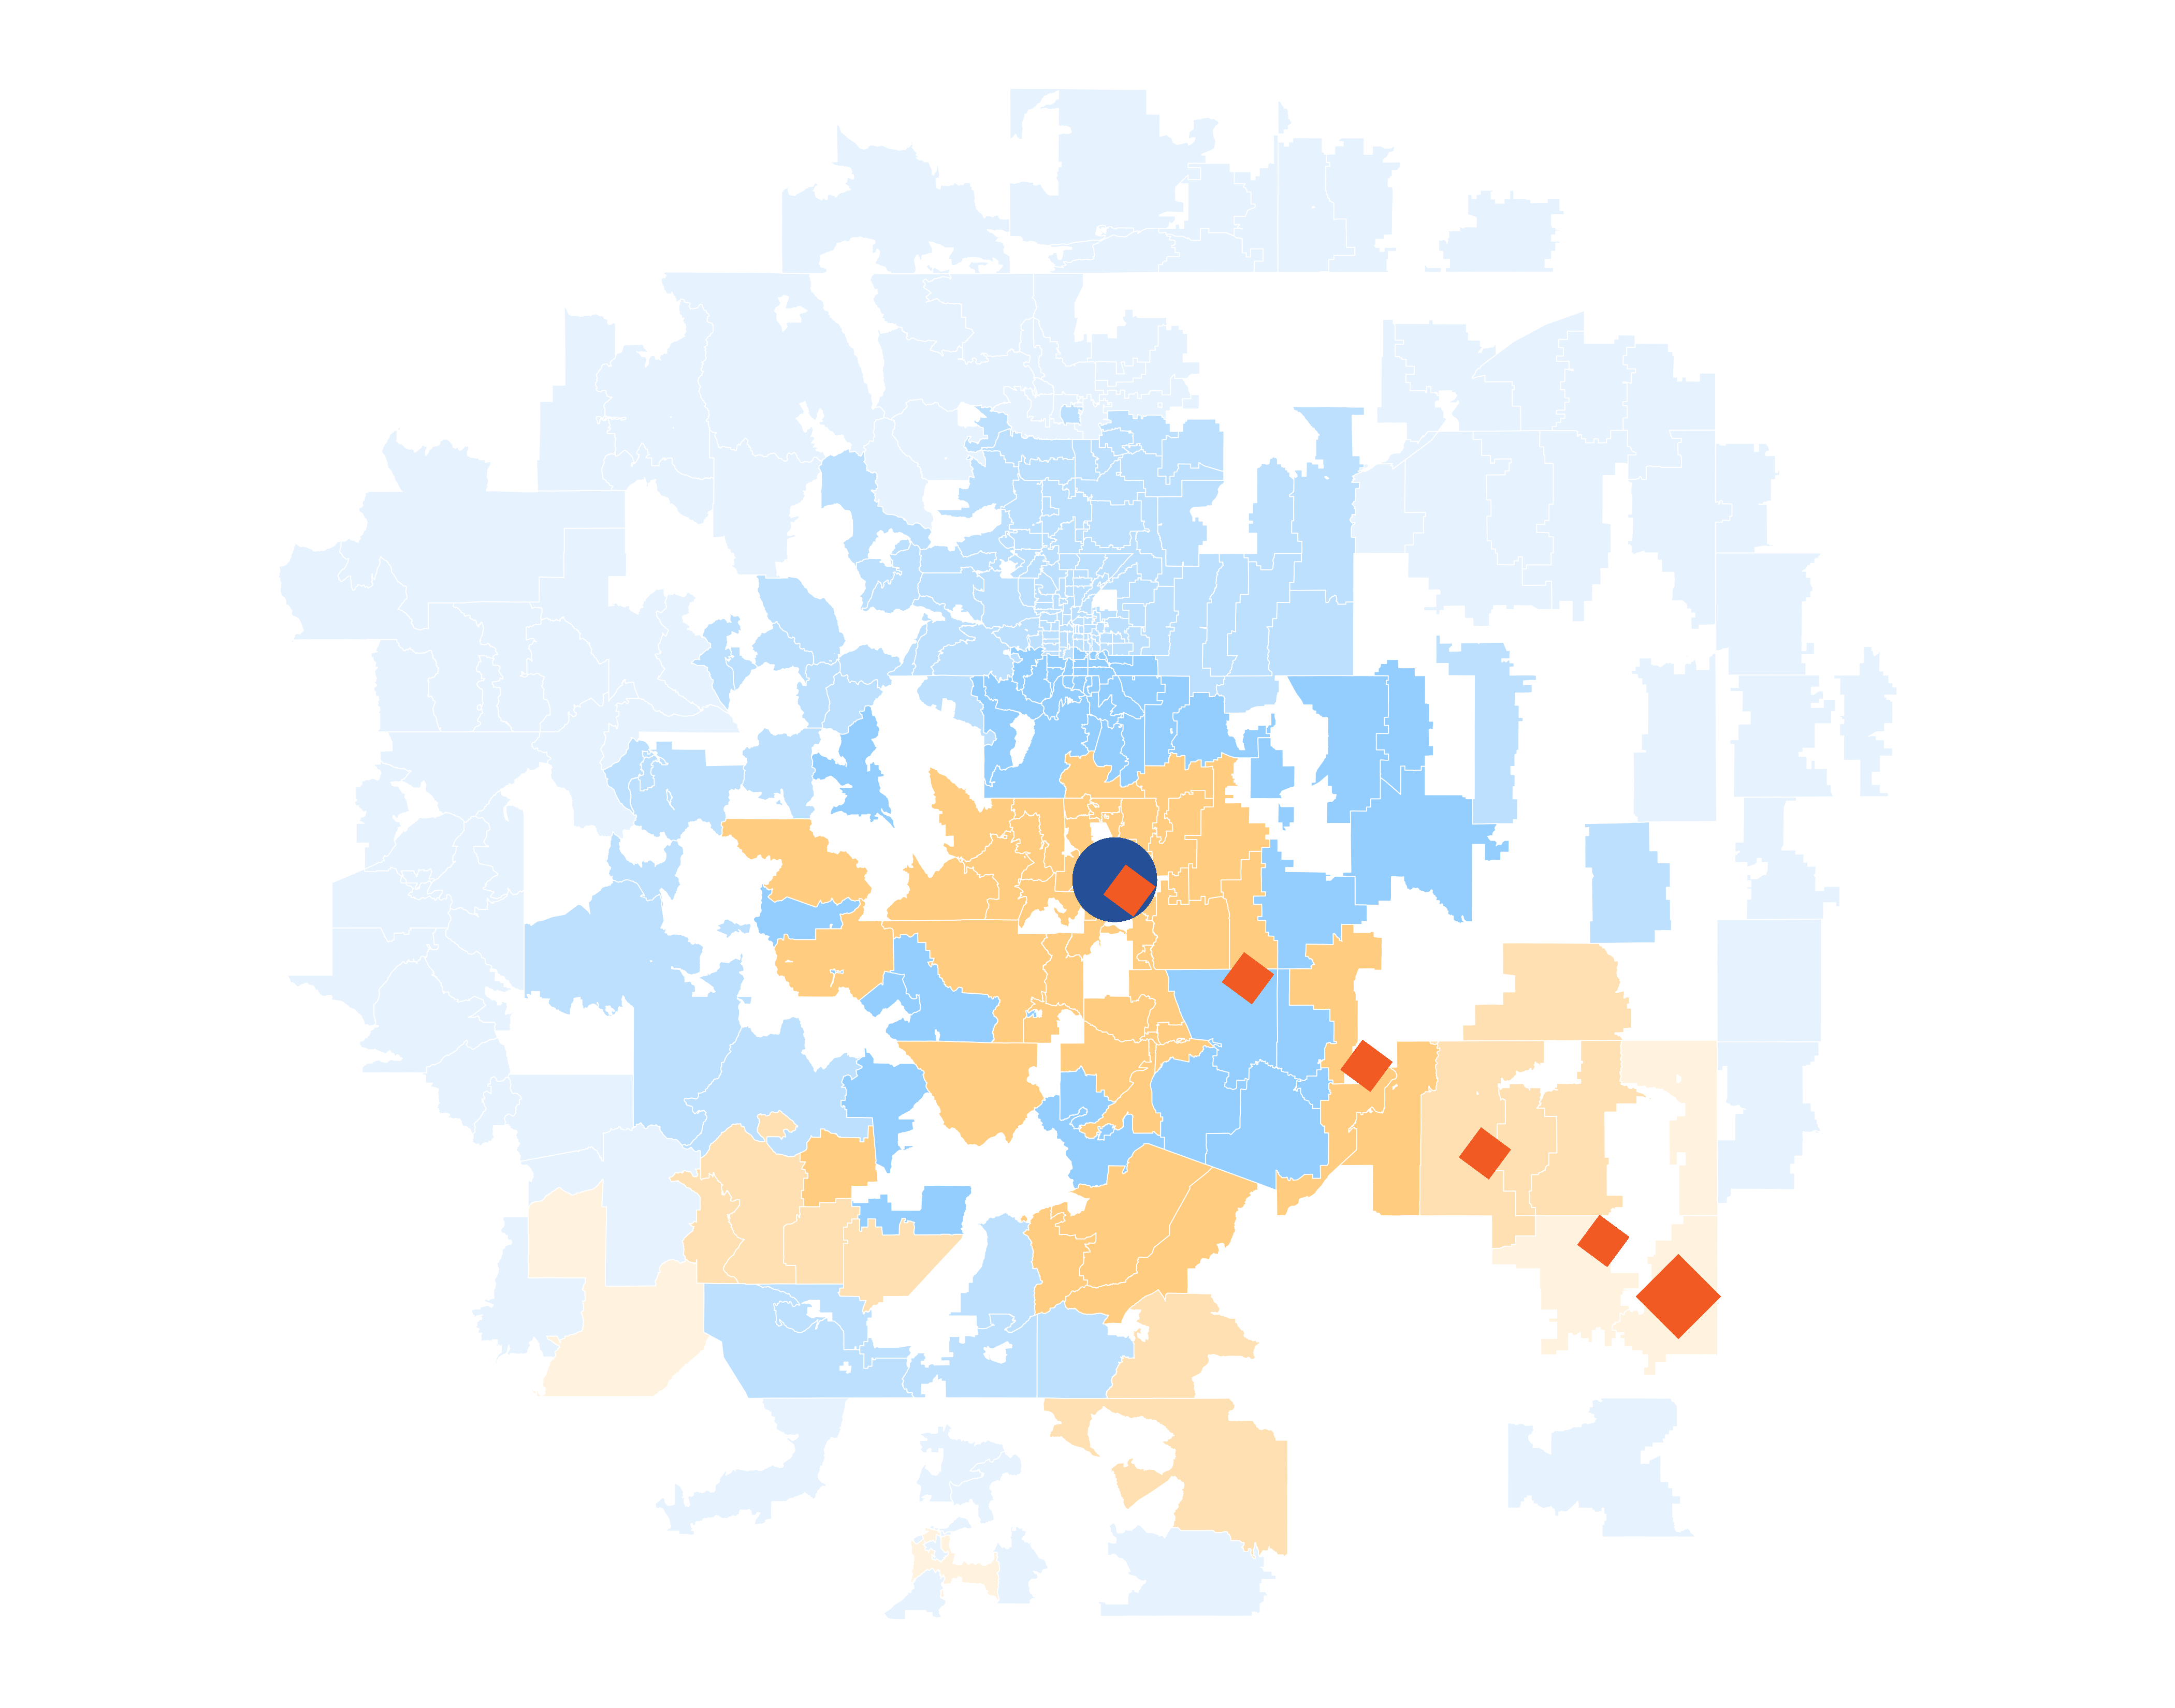
Patients Pass Other Hospitals to Come to UCHealth
KBA models Medicare patient encounter data to identify strong health system brands where patients will travel past other hospitals or long distances to frequent a specific hospital.
The center of the donut are zip codes within which patients have a higher probability of frequenting . These zip codes are ignored for this analysis.
Significant patient encounters outside of this center, as seen here, indicate that patients are willing to travel significant distances, passing other hospitals to go to .
14 patients (admissions) traveled 277.8 miles to UCHealth Memorial Hospital Central despite 57 closer hospitals.

Slide 11
SINGLE YEAR SUMMARY
DTE Covered Members Financial Analysis | DTE Covered Members Financial Analysis | DTE Covered Members Financial Analysis | DTE Covered Members Financial Analysis | DTE Covered Members Financial Analysis | DTE Covered Members Financial Analysis | DTE Covered Members Financial Analysis | DTE Covered Members Financial Analysis
Target Estimate Assuming 50%+ Within-Plan Steerage and a Commercial Margin of 33.6%. | Target Estimate Assuming 50%+ Within-Plan Steerage and a Commercial Margin of 33.6%. | Target Estimate Assuming 50%+ Within-Plan Steerage and a Commercial Margin of 33.6%. | Target Estimate Assuming 50%+ Within-Plan Steerage and a Commercial Margin of 33.6%. | Target Estimate Assuming 50%+ Within-Plan Steerage and a Commercial Margin of 33.6%. | Target Estimate Assuming 50%+ Within-Plan Steerage and a Commercial Margin of 33.6%. | Target Estimate Assuming 50%+ Within-Plan Steerage and a Commercial Margin of 33.6%. | Target Estimate Assuming 50%+ Within-Plan Steerage and a Commercial Margin of 33.6%.
DTE Members | Pre-DTE Revenue | Pre-DTE Margin | DTE Revenue | DTE Incr. Revenue | DTE Total Margin | DTE Incr. Margin | Net Margin Less DTE Fees
100 | $ 236K | $ 79K | $ 619K | $ 383K | $ 208K | $ 129K | $ -200K
500 | $ 1,180K | $ 396K | $ 3,093K | $ 1,913K | $ 1,039K | $ 643K | $ 319K
1,000 | $ 2,359K | $ 793K | $ 6,185K | $ 3,826K | $ 2,078K | $ 1,286K | $ 968K
2,500 | $ 5,898K | $ 1,982K | $ 15,463K | $ 9,565K | $ 5,195K | $ 3,214K | $ 2,914K
10,000 | $23,590K | $ 7,926K | $ 61,850K | $38,260K | $20,782K | $12,855K | $12,645K
20,000 | $47,181K | $15,853K | $123,700K | $76,520K | $41,563K | $25,711K | $25,621K
NOTE: Please see detailed financial analysis and assumptions used starting on page 26.
Financial projections do not include 340B contribution margin, which could represent $136 PMPM by optimizing 340B through Rx plan design, UCHealth’s approved site(s) with network integration, and development of UCHealth’s proprietary PBM program.

Slide 12
Year 4 Projected Revenue and Profit
Pre-DTE Cohort of 16,600 Employees | Inpatient | Outpatient | Professional | Total
Revenue† | $ 14,627,038 | $ 16,723,206 | $ 7,809,595 | $ 39,159,839
Net Income‡ | $ 4,914,685 | $ 5,618,997 | $ 2,624,024 | $ 13,157,706
† Assuming proportional revenues from market shares of 28% (inpatient) and 17% (outpatient)
‡ Conservatively assuming a commercial margin of 33.6% (80% of the estimated commercial margin)
With DTE | Inpatient | Outpatient | Professional | Total
Revenue⁰ | $ 35,546,478 | $ 55,697,918 | $ 26,010,454 | $ 117,254,850
Net Income* | $ 11,943,617 | $ 18,714,500 | $ 8,739,513 | $ 39,397,629
⁰ Assuming 67% inpatient and 58% market steerage based on KBA narrow network DTE experience (see previous slide)
* Conservatively assuming a commercial margin of 33.6%, with a 10 percentage-point reduction to reflect competitive-edge rates and a 10 percentage-point increase due to lower billing costs and higher patient responsibility collections because of the member credit card.
Total Increase in Net Income | $ 26,239,924
Network Access Fee (Revenue) of $1 PMPM | $ 199,200
Total Profit Growth | $ 26,244,724
Minus Implementation Fee (One-Time) | -$ 0
Minus Sales and Marketing (Annual – Ongoing) | -$ 180,000
Total | $ 26,259,124

Slide 13

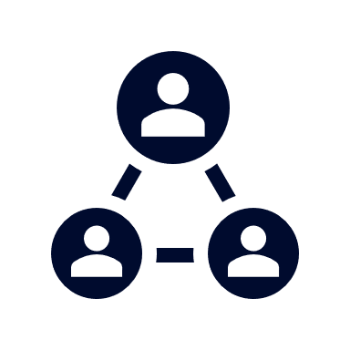



A Partner You Can Trust
OUR OBJECTIVES ARE ALIGNED
WE KNOW THE
MARKET
COMPLETELY TRANSPARENT
WE HAVE THE SOPHISTICATION AND INFRASTRUCTURE TO EFFECTIVELY COMPETE
Derek Moore, Senior Vice President – KBA
845-283-9973 * derek.moore@keybenefit.com

